Slide 1
SENTENCE AUTOCOMPLETE
P.Maanasa-192210382
V.Priyanka-192210360
M.Sri Harshini-192210287

Slide 2
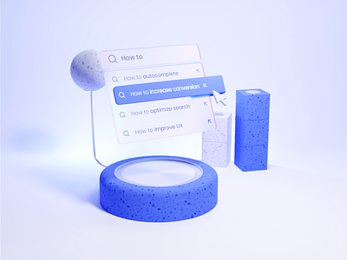
Table Of Contents:
Introduction of Sentence Auto complete
Objective
Abstract
Algorithm and Architecture
Screenshot
Conclusion
References

Slide 3
Introduction
The Sentence Auto complete project aims to improve typing efficiency and user experience by predicting and suggesting the next words or phrases in a sentence.
Utilizing machine learning and natural language processing (NLP), the system understands context to provide accurate predictions.
This technology can be used in various applications, such as email composition, coding, messaging apps, and other text input interfaces, to enhance productivity and ease of use.
By reducing the amount of typing required, Sentence Auto complete streamlines the writing process and ensures a smoother, more efficient user experience.

Slide 4
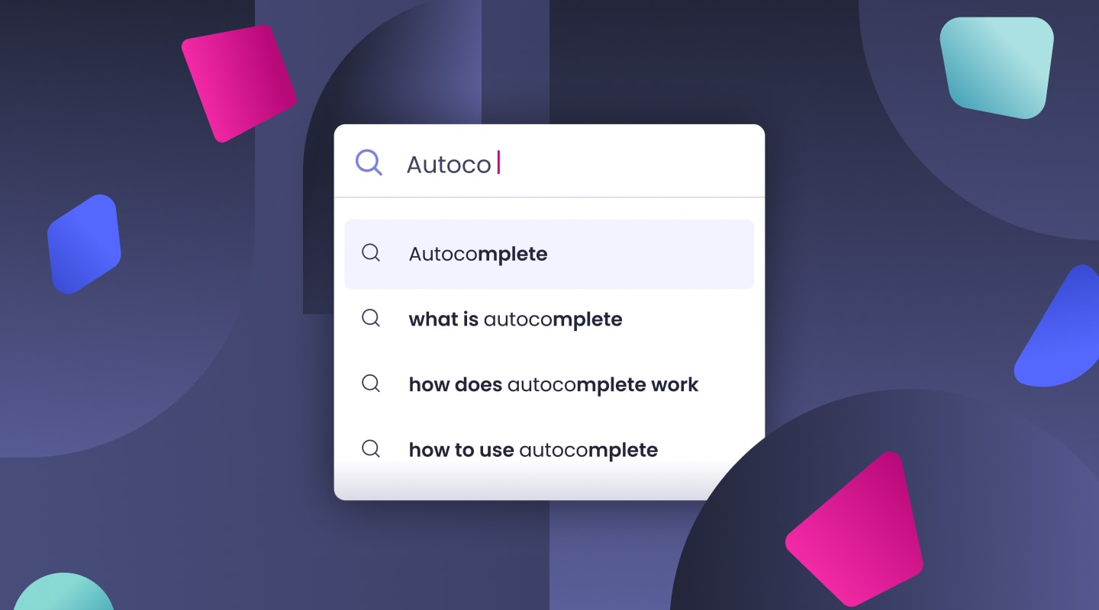
Objectives
Predict Next Words: Develop a system that can predict and suggest the next words or phrases in a sentence.
Improve Typing Efficiency: Reduce the amount of typing required by users.
Enhance User Experience: Provide accurate and contextually relevant suggestions.
Support Multiple Languages: Extend the autocomplete functionality to multiple languages

Slide 5

Advantages In Sentence Auto complete
Increased Typing Speed, Enhanced Productivity, Improved Accuracy, Contextual Relevance, User Convenience, Reduced Cognitive Load, Personalization, Language Support, Consistency, Accessibility

Slide 6
Abstract
The Sentence Autocomplete project aims to create a system that enhances text input interfaces by predicting and suggesting the next words or phrases based on the context of the current input.
By utilizing advanced machine learning models and NLP techniques, the system can significantly improve typing speed and user experience.
This document details the algorithm, architecture, implementation, and potential applications of the Sentence Autocomplete system.

Slide 7
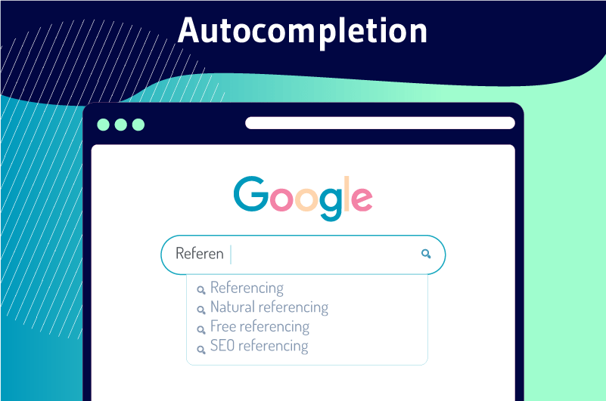
Role Of NLP
NLP plays a crucial role in sentence autocomplete by understanding the context of the current text to predict relevant next words or phrases.
NLP adapts to individual user writing styles for personalized suggestions, provides synonyms and alternative phrases, and supports multiple languages.
By understanding the meaning behind words through semantic analysis, it offers contextually appropriate suggestions and completes entire phrases for more efficient typing.

Slide 8
Real time uses:
Real-time uses of sentence autocomplete with NLP include email composition
messaging apps
coding assistants
document editing
search engines
customer support
social media
accessibility tools
language learning apps
chatbots.

Slide 9
Flowchart:
Input Interface,
Context Analysis
Prediction engine
Suggestion Display
User Selection,
Feedback System
Database

Slide 10
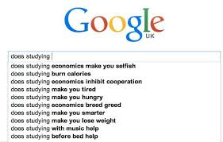
Challenges And Limitations
Context Understanding
Handling Ambiguity
Personalization
Language Variations
Real-Time Processing
Data Privacy
Bias in Predictions
User Trust
Complex Sentence
Structures
Resource Intensive

Slide 11
import re
from collections import defaultdict, Counter
class SentenceAutocomplete:
def __init__(self, corpus):
self.word_counts = Counter()
self.word_followers = defaultdict(Counter)
self.preprocess(corpus)
def preprocess(self, corpus):
# Tokenize the corpus into words
tokens = re.findall(r'\b\w+\b', corpus.lower())
# Count occurrences of each word and word pairs
for i in range(len(tokens) - 1):
self.word_counts[tokens[i]] += 1
self.word_followers[tokens[i]][tokens[i + 1]] += 1
def suggest(self, prefix, max_suggestions=5):
# Get suggestions based on the last word in the prefix
last_word = prefix.split()[-1].lower()
suggestions = self.word_followers[last_word].most_common(max_suggestions)
return [word for word, _ in suggestions]
# Example corpus
corpus = """
The quick brown fox jumps over the lazy dog.
The quick brown fox is very quick and very brown.
Lazy dogs are not quick but they are very lazy.
"""
# Initialize the autocomplete system
autocomplete = SentenceAutocomplete(corpus)
# User input
input_text = input("Start typing your sentence: ")
# Get suggestions
suggestions = autocomplete.suggest(input_text)
print("Suggestions:", suggestions)
Execution And output:
Start typing your sentence: The quick
Suggestions: ['brown', 'and', 'is']

Slide 12
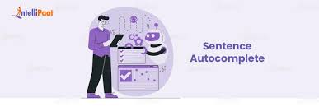
Conclusion
This project demonstrates a basic sentence autocomplete system using NLP, providing word suggestions based on bigram frequencies.
It's a simple yet effective way to enhance text input efficiency.

Slide 13

References:
Shaikh, Aryaan, et al. "Autocomplete recommendation plugin and Summarizing Text using Natural Language Processing." Journal of Innovation Information Technology and Application (JINITA) 5.2 (2023): 114-123.
Lee, Mina, Tatsunori B. Hashimoto, and Percy Liang. "Learning autocomplete systems as a communication game." arXiv preprint arXiv:1911.06964 (2019).
Shaikh, A., Newalkar, N., Gaikwad, S., Kadav, N. and Shewale, C., 2023. Autocomplete recommendation plugin and Summarizing Text using Natural Language Processing. Journal of Innovation Information Technology and Application (JINITA), 5(2), pp.114-123.

Slide 14


